Slide 1
















RoleBook
The Ultimate Classroom Management System
Team members:
MIRIAM BERG
BRACHA DRILLICK
MINNIE EISENSTEIN
DINA SITTNER

Slide 2

What is RoleBook?
RoleBook is a classroom management software designed to make teaching and learning more efficient and organized.
It helps teachers with essential tasks like:
Keeping track of grades and assignments.
Recording and analyzing attendance.
Monitoring overall class and individual student performance.
It provides students with access to their own performance data, making it easy for them to stay informed about their grades, attendance, and feedback.
The system is designed with user-friendly menus for seamless navigation and a professional yet approachable design.

Slide 3




Teacher view
Student management: Add, remove, and update student records.
Assignment management: Create, grade, and analyze assignments.
Attendance tracking: Record and analyze attendance.
Performance insights: Identify top/weakest students and overall class performance.
Views overview
Student View
View Grades: Access marks for all assignments and exams, organized by type (Quiz, Test, Essay, etc.).
See Attendance: Check attendance records, including dates of absence and whether they were excused or unexcused.
Monitor Performance: View top marks, lowest marks, and their overall grade average.
Access Feedback: Read comments left by the teacher about their work or behavior.
Customized Reports: Generate detailed performance reports (e.g., by subject or assignment type).
Grading Structure: Understand how different assignment types and attendance contribute to their final grade.
Change Password: Maintain account security with the option to update their password.
RoleBook serves a dual purpose; it enables teachers to record and track student performance while also allowing students to access their own academic records.

Slide 4


Managing Students Made Easy
Add new students with automatically generated unique IDs and passwords.
Remove students from the class list.
View all students, including their averages, top marks, and comments.

Slide 5


Comprehensive Assignment Management
Add new assignments with types like Quiz, Test, Homework, and Attendance.
Assign and adjust weights to ensure they total 100%.
Record, view, and change marks for students.
Analyze assignment data with averages and mode calculation.

Slide 6

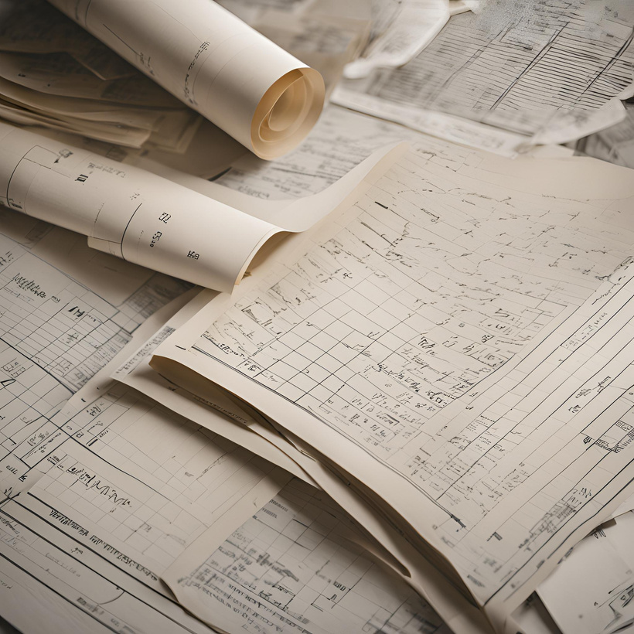
Attendance Made Simple
Add attendance for all students on a specific date.
Track individual student attendance records.
Excuse absences dynamically.
Calculate attendance grades as part of the weighted grading system.

Slide 7





Analyzing Class Performance
View class averages to track overall performance.
Identify top-performing and weakest students based on grades.
Track failing students for timely intervention.

Slide 8


Empowering students
To take charge of their academic journey by promoting awareness of their current grades.
Students can view:
Top marks and lowest marks for assignments.
Attendance records and grading structure.
Customized teacher feedback and comments.

Slide 9

Transparency in Grading
To take charge of their academic journey by promoting awareness of their current grades.
Students can view:
Students can view the grading structure:
Assignment types and weights (e.g., Quizzes: 10%, Tests: 20%, Attendance: 10%).
Helps students understand how grades are calculated, and distribute their studying efforts apropiately.

Slide 10
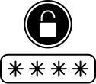
Ensuring Security and Role-Based Access
RoleBook is designed with robust security to ensure appropriate access for teachers and students. Key security measures include:
Separate Views for Teachers and Students:
Teachers: Access tools to manage assignments, grades, attendance, and student records.
Students: Restricted to viewing their grades, attendance, and performance without the ability to modify any data.
Secure Login System:
Each user has a unique ID and password.
Teachers and students must log in with their credentials to access their respective views.
Password Management:
Teachers and students can change their passwords within the system for enhanced security.
Data Integrity:
Students cannot access or modify other students’ information.
The Teacher View is protected by an additional layer of control, preventing unauthorized access.

Slide 11


Attendance Tracking
Easily manage student attendance with the ability to record daily attendance, view attendance by date, excuse absences, and calculate attendance grades, seamlessly integrated into the grading system.
Weight-Based Grading
Grade calculations are based on customizable assignment weights (e.g., quizzes, tests, attendance), allowing flexibility to match your class's grading policies.
Averages
Automatically calculate and display class averages, assignment averages, and individual student averages, ensuring a clear view of overall performance.
feature highlights
Top and Lowest Marks
View the top-performing or weakest students in the class with just a few clicks, helping teachers identify trends and provide targeted support.
Behavior Tracking
Teachers can add personalized comments for students to track behavior and provide qualitative feedback, improving communication and accountability.
Customized Reports for Students
Generate tailored reports showing a student's performance across assignments, attendance, and overall grades, enhancing transparency and engagement.

Slide 12





The software development process
October 5, 2024 - Initial Planning
November 6, 2024 - Feedback Integration
November 17, 2024 - File System Implementation
December 2, 2024 - Program Redesign
December 16, 2024 - Final Refinements
December 30, 2024 - Project Completion
Held the first meeting to brainstorm ideas and establish communication protocols.
Agreed on RoleBook's primary goal: to serve as a teacher's personal grading system for managing a single class effectively.
Incorporated client suggestions, such as adding password protection, tracking failing students, and enhancing user security.
Initially explored adding file storage to save data and an admin view for multi-class functionality.
Realized file storage didn’t align with the real-time simplicity needed for a RoleBook program.
Removed the admin view and refocused on the original goal: a user-friendly tool for a single teacher managing one class.
Simplified RoleBook to eliminate file storage, opting for an efficient, non-persistent approach.
Finalized key features such as attendance tracking, student management, grading weights, and behavior comments.
Enhanced usability with intuitive menus for both Teacher and Student views.
Resolved merge conflicts and polished the overall functionality.
Began integrating a file-based system for saving student data and reports.
Experimented with a more complex grading system resembling a school-wide solution.
Delivered Rollbook as a robust, goal-oriented tool for teachers to manage their classrooms effectively.
Prepared for demonstration, emphasizing how Rollbook achieves simplicity and efficiency without unnecessary complexity.

Slide 13

RoleBook:
Empowering Teachers and Students
Our goal:
How We Achieve It:
TO CREATE A SEAMLESS PLATFORM THAT ENHANCES CLASSROOM EFFICIENCY AND TRANSPARENCY FOR BOTH TEACHERS AND STUDENTS.
STREAMLINED MANAGEMENT: SIMPLIFIED TOOLS FOR TRACKING ATTENDANCE, ASSIGNMENTS, AND GRADES.
ENHANCED STUDENT ENGAGEMENT: FEATURES LIKE CUSTOMIZED REPORTS AND DETAILED PERFORMANCE INSIGHTS.
DATA INTEGRITY: CLEAR SEPARATION OF TEACHER AND STUDENT VIEWS, ENSURING SECURITY AND ACCURACY.
FLEXIBILITY: WEIGHTED GRADING, BEHAVIOR TRACKING, AND ATTENDANCE INTEGRATION TO MEET DIVERSE CLASSROOM NEEDS.

Slide 14

Why the Name "RoleBook"?
The name "RoleBook" is a modern twist on the traditional rollbook, a tool teachers have used for decades to track grades and attendance.
RoleBook adds a new layer by adapting to the user's role:
Teacher View: Focused on managing the classroom, assignments, attendance, and student performance.
Student View: Offers students a personal portal to track their progress and attendance.
RoleBook is built to do more by combining the simplicity of rollbooks with enhanced functionality for different roles.

Slide 15
Thank you!
Presented by:
MIRIAM BERG BRACHA DRILLICK, MINNIE EISENSTEIN, DINA SITTNER

